Slide 1
Penetration Testing in Financial Institutions
COINS Ph.D. student seminar 2016
Oleksandr kazymyrov, technical test analyst

Slide 2
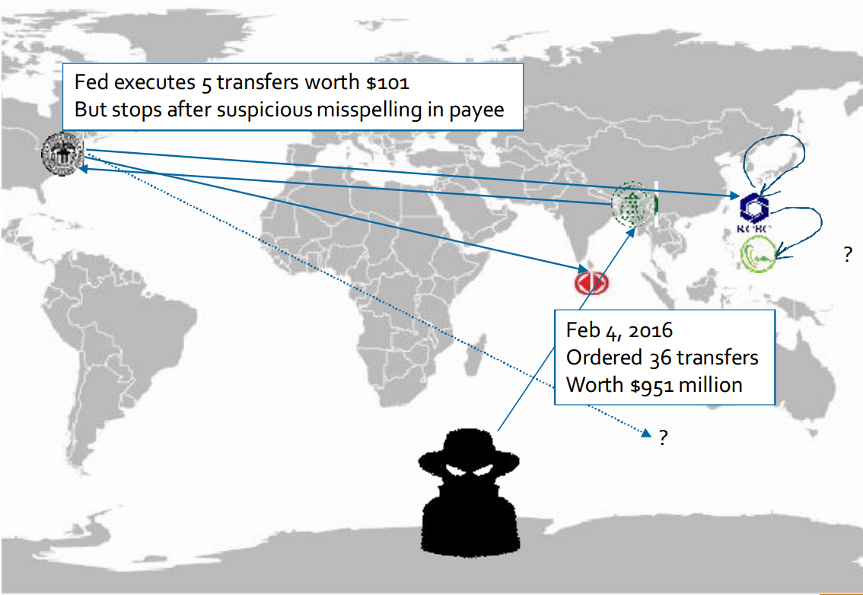
How the SWIFT Hack Went Down and How to Benefit from the Lessons Learned
Agenda of the webinar :
The sophisticated techniques used during the SWIFT hack, affecting the network, operating system, application and database layer.
Key strategies and technologies to put in place for attack prevention and proper response.
How Carbon Black can help you to implement the right level of protection and monitoring for different classes of systems.
Source: https://www.carbonblack.com/webinars/swift-attack/

Slide 3
Agenda
Chapter I – Brief Introduction
Chapter II – What Is Penetration Testing?
Chapter III – Pentest in Financial Institutions
Chapter IV – Security Incidents
Chapter V – Summary

Slide 4
Brief Introduction
Chapter I

Slide 5

Who am I?
Education
Job
Technical Test Analyst at EVRY
Candidate of Engineering Sciences in Information Security
KHNURE, Ukraine
Ph.D. in Cryptology
University of Bergen, Norway
Additional
Certificates
Certified Ethical Hacker
Certified Encryption Specialist
Standards
DSTU 7624:2014
DSTU 7564:2014
Penetration Tester in Financial Services at EVRY

Slide 6
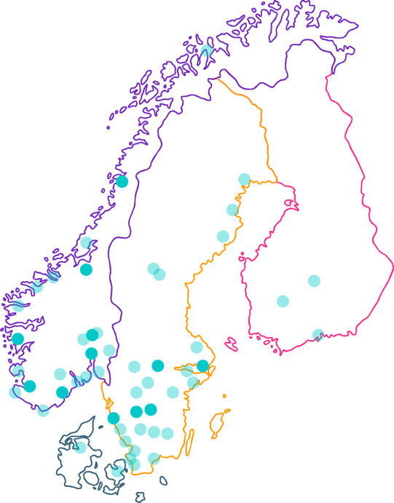

EVRY
– Nordic Champion
50 towns and cities with capacity to deliver
11 regional offices with specialist competencies
10.000 employees
Women
Age
Universum
26%
39yrs
#4
100+ employees

Slide 7


EVRY GROUP - Geographic distribution
Nordics
Rest of the World (Global Delivery)

Slide 8
NFT Department
Performance
Application layer
Security
Load
Endurance
Stress
Spike
Network layer
Wireless
PCI DSS
Reliability
Failover
Interruption
Recoverability
Load balancing
Front-end

Slide 9
What Is Penetration Testing?
Chapter II

Slide 10
Base Definitions
Threat
Vulnerability
Exploit

Slide 11


Vulnerability Scanning vs Penetration Testing
Corvin Castle in Transylvania
Source: https://en.wikipedia.org/wiki/File:Hunyad_Castle_TB1.jpg

Slide 12
Types of Penetration Tests
Penetration Tests
Technical
Social Engineering
Physical

Slide 13
High-Level Overview
Information Gathering
Vulnerability Analysis
Attack Modeling
Exploitation
Evidence Retention
Scoping
Rules of Engagement
Success Criteria
Sign Off
Cleaning up
Reporting
Remediation Mitigation
Retesting
Pre-Engagement
Engagement
Post-Engagement

Slide 14
Timeline of a Penetration Test
Internal
Start
Finish
Information gathering
Vulnerability scanning
Post-exploitation
Service and operating system identification
Exploitation
Pivoting
Information gathering
Vulnerability scanning
Service and operating system identification
Exploitation
External

Slide 15
Workflow of a Penetration Test
Information Gathering
Vulnerability
Analysis
Attack Modelling
Attack Execution
Reporting
Retesting

Slide 16
Why conduct a penetration test?
Prevent data breach
Test security controls
Ensure system security
Get a base line
Compliance

Slide 17
Pentest in Financial Institutions
CHAPTER III

Slide 18
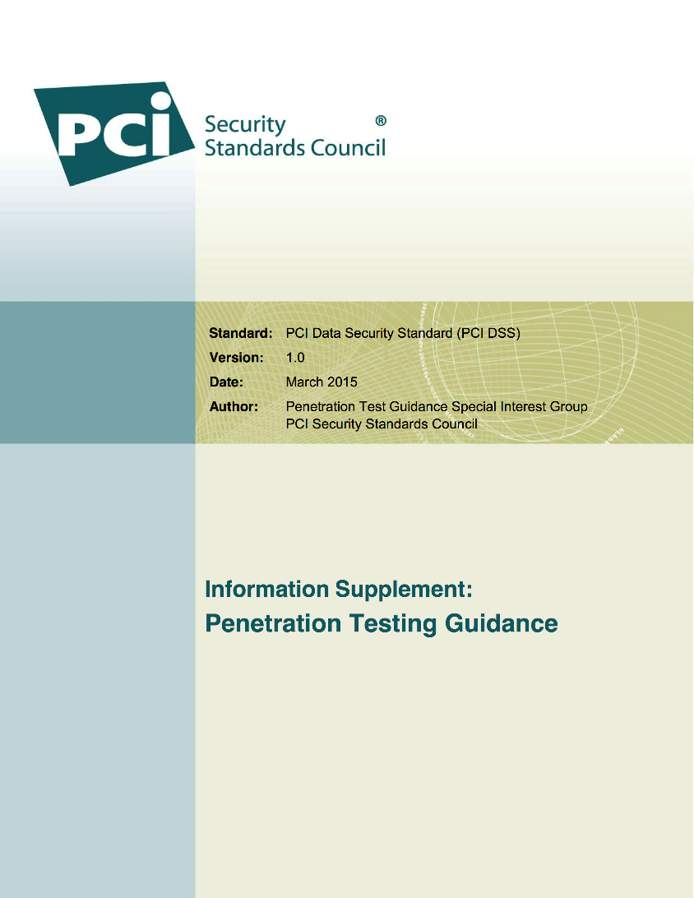
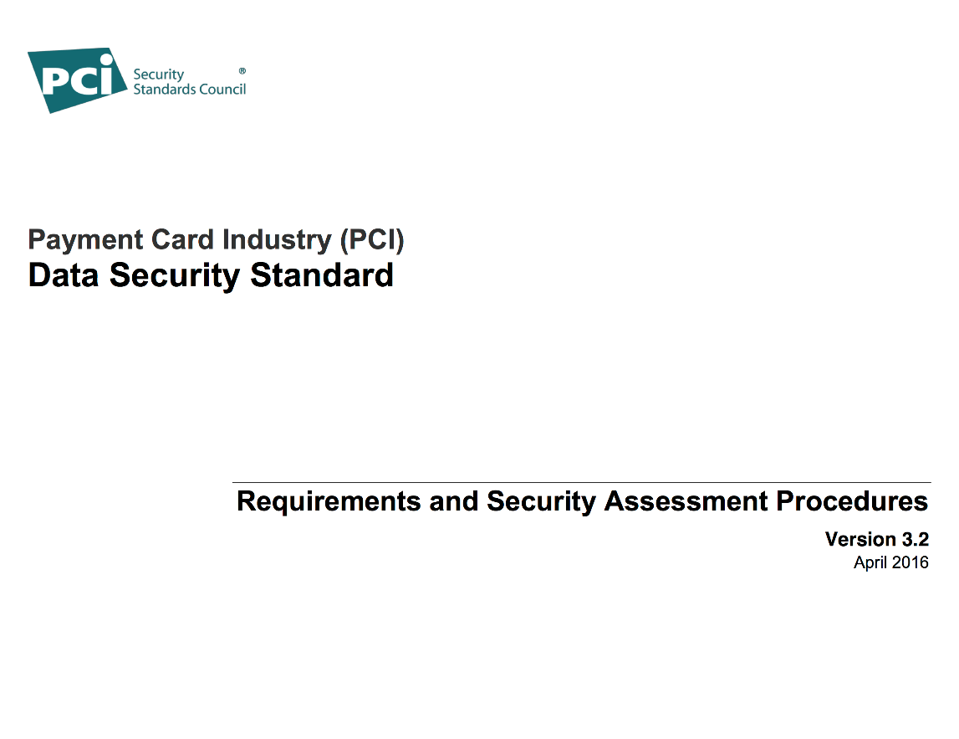
PCI DSS

Slide 19
PCI DSS: What? When?
Requirement 11.3.1
“Perform external penetration testing at least annually and after any significant infrastructure or application upgrade or modification (such as an operating system upgrade, a sub-network added to the environment, or a web server added to the environment).”
Requirement 11.3.2
“Perform internal penetration testing at least annually and after any significant infrastructure or application upgrade or modification (such as an operating system upgrade, a sub-network added to the environment, or a web server added to the environment).”

Slide 20
Penetration testing Guidance: How?
Penetration Testing Components
Understanding of the different components that make up a penetration test and how this differs from a vulnerability scan including scope, application and network layer testing, segmentation checks, and social engineering
Qualifications of a Penetration Tester
Determining the qualifications of a penetration tester, whether internal or external, through their past experience and certifications.
Penetration Testing Methodologies
Detailed information related to the three primary parts of a penetration test: pre-engagement, engagement, and post-engagement.
Penetration Testing Reporting Guidelines
Guidance for developing a comprehensive penetration test report that includes the necessary information to document the test as well as a checklist that can be used by the organization or the assessor to verify whether the necessary content is included.

Slide 21
PCI DSS Penetration Testing
External
AL
NL
Internal
AL
NL
Segmentation Checks

Slide 22
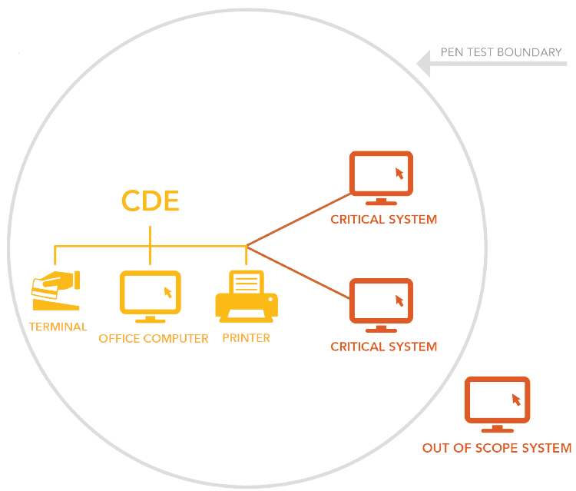
Cardholder Data Environment (CDE)
Source: https://www.securitymetrics.com/static/resources/orange/new-penetration-testing-requirements-explained.pdf

Slide 23
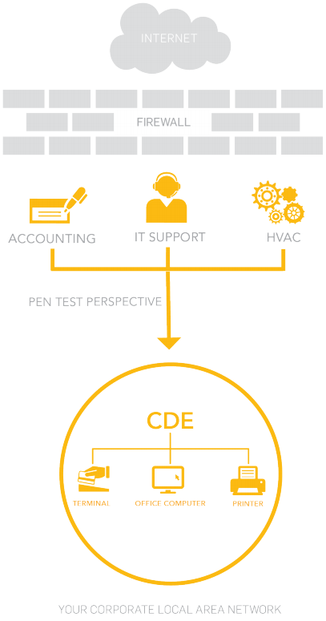
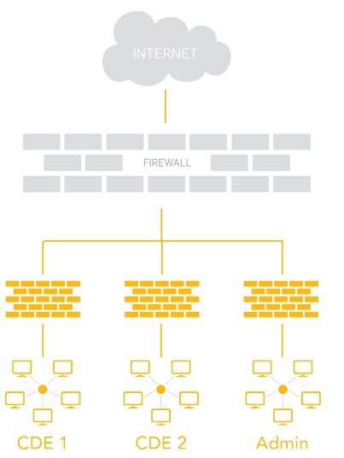
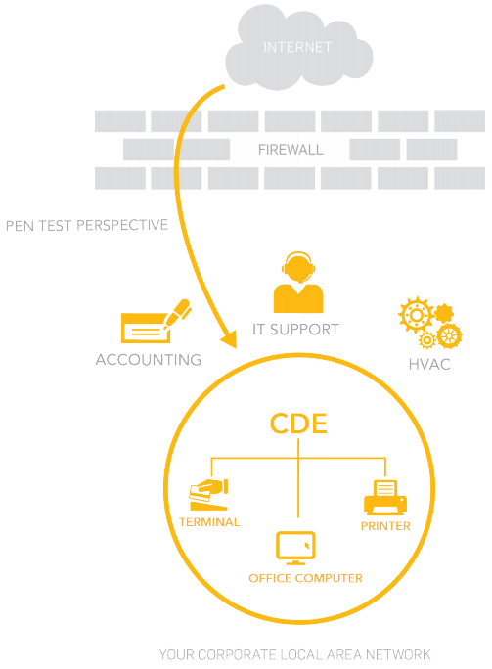
Scope for PCI DSS Pentest
External
Internal
Segmentation
Source: https://www.securitymetrics.com/static/resources/orange/new-penetration-testing-requirements-explained.pdf

Slide 24
Security Incidents
CHAPTER IV

Slide 25
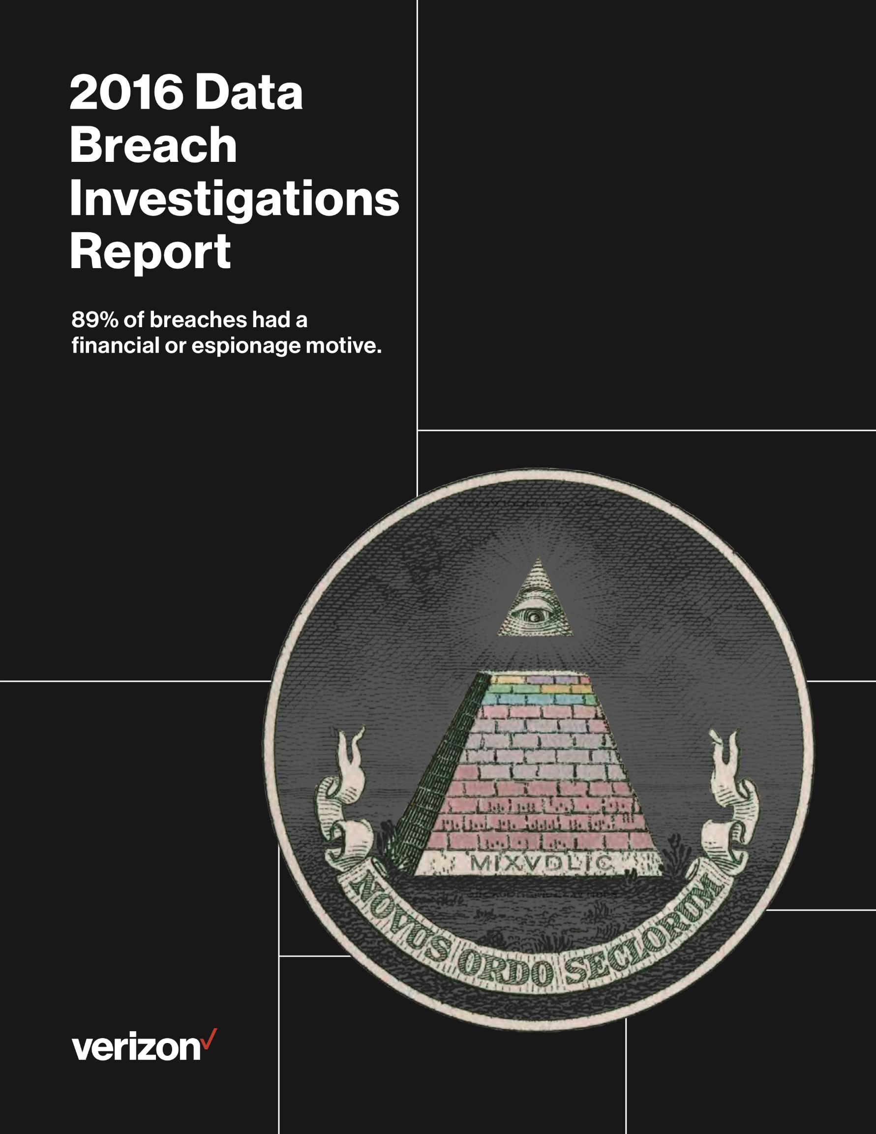

2016 Data Breach Investigations Report
Source: http://www.verizonenterprise.com/resources/reports/rp_DBIR_2016_Report_en_xg.pdf

Slide 26
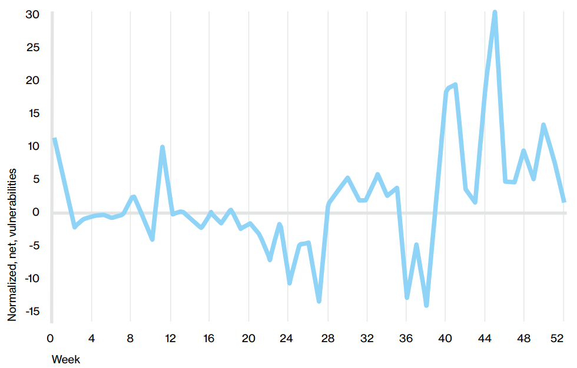
Delta of Number of Vulnerabilities Opened Each Week and Number Closed
Source: http://www.verizonenterprise.com/resources/reports/rp_DBIR_2016_Report_en_xg.pdf

Slide 27
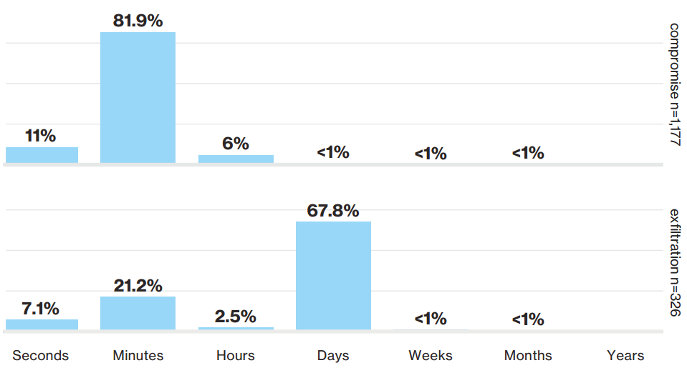
Time to Compromise and Exfiltration
Source: http://www.verizonenterprise.com/resources/reports/rp_DBIR_2016_Report_en_xg.pdf

Slide 28
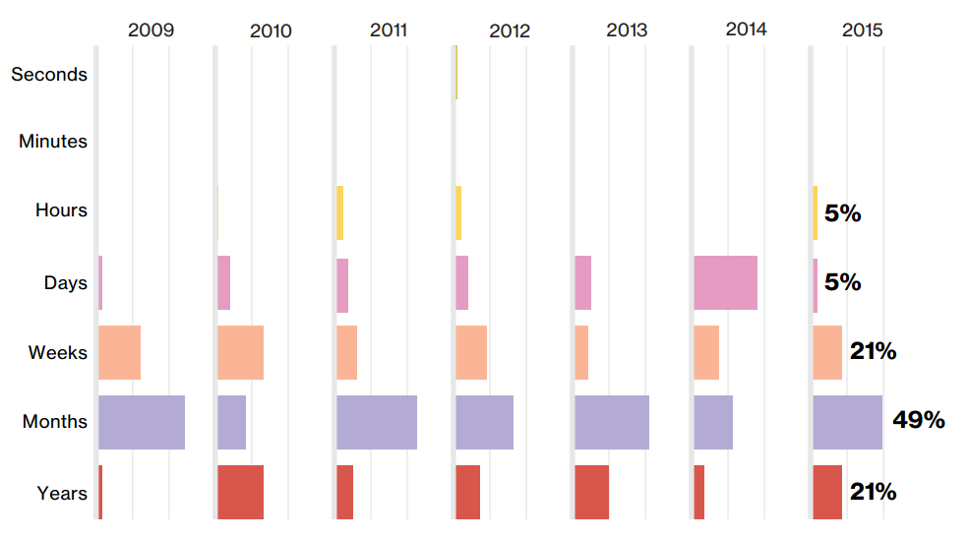
Discovery Timeline Within Insider and Privilege Misuse Over Time
Source: http://www.verizonenterprise.com/resources/reports/rp_DBIR_2016_Report_en_xg.pdf

Slide 29
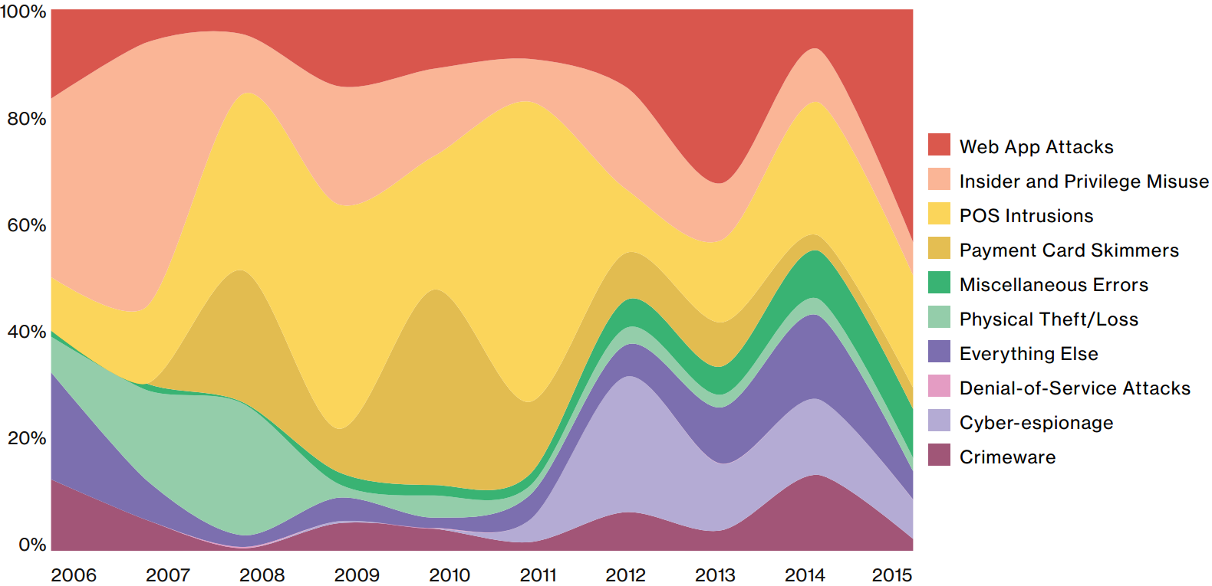
Frequency of Incident Classification Patterns Over Time Across Confirmed Data Breaches
Source: http://www.verizonenterprise.com/resources/reports/rp_DBIR_2016_Report_en_xg.pdf

Slide 30
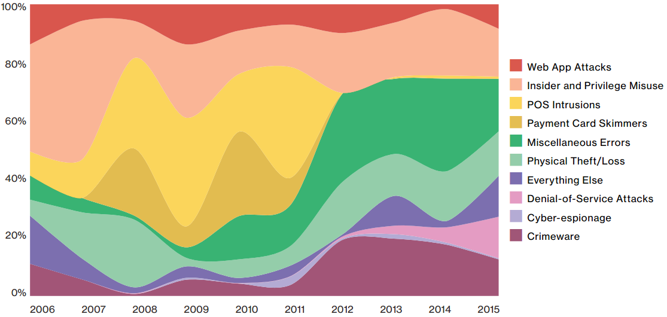
Frequency of Incident Classification Patterns Over Time Across Security Incidents
Source: http://www.verizonenterprise.com/resources/reports/rp_DBIR_2016_Report_en_xg.pdf

Slide 31
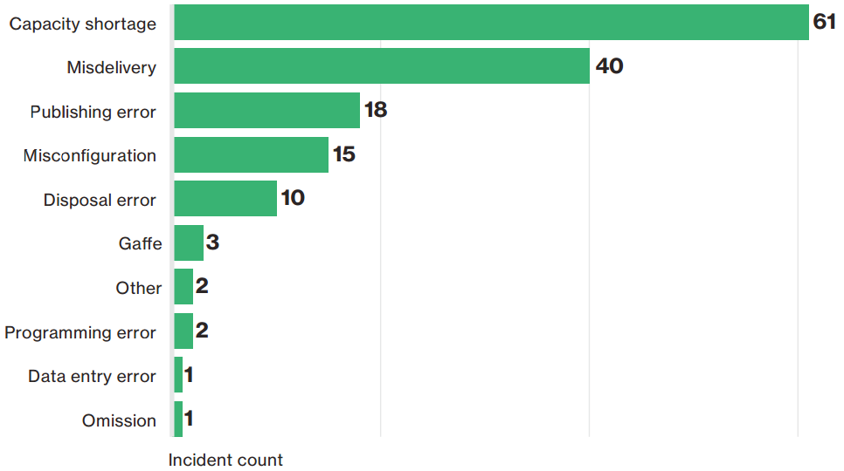
Top 10 Threat Action Varieties Within Miscellaneous Errors, Excluding Public
Source: http://www.verizonenterprise.com/resources/reports/rp_DBIR_2016_Report_en_xg.pdf

Slide 32
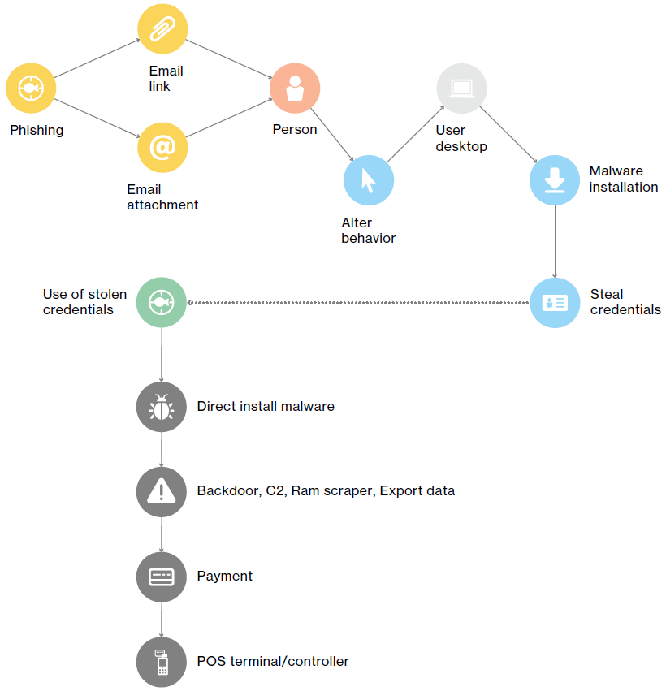
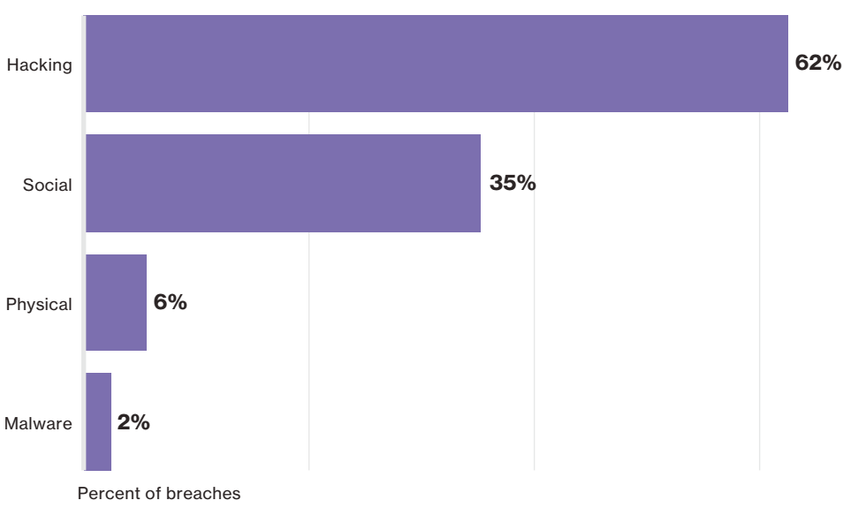
Summary
Threat Actions Within Everything Else Breaches
Source: http://www.verizonenterprise.com/resources/reports/rp_DBIR_2016_Report_en_xg.pdf

